Slide 1
Essentials of
Systems Analysis and Design
Sixth Edition
Joseph S. Valacich
Joey F. George
Jeffrey A. Hoffer
Chapter 10
Systems Implementation and Operation
10.1

Slide 2
Learning Objectives
Describe the process of coding, testing, and converting an organizational information system
Discuss four installation strategies
  Direct
  Parallel
  Single location
  Phased installation
Describe the deliverables for documenting the system and for training and supporting the users
10.2

Slide 3
Learning Objectives (continued)
Compare the many modes available for organizational system training, including self-training and electronic performance support systems
Discuss the issues of providing support to end users
Discuss system implementation failure
Explain four types of maintenance
Describe several factors that influence the cost of maintaining an information system
10.3

Slide 4
System Implementation and Operation
Seven major activities
  Coding
  Testing
  Installation
  Documentation
  Training
  Support
  Maintenance
Purpose
  To convert final physical system specifications into working and reliable software
  To document work that has been done
  To provide help for current and future users
10.4

Slide 5
The Processes of Coding, Testing and Installation
Coding
  Physical design specifications are turned into working computer code
Testing
  Tests are performed using various strategies
  Testing can be performed in parallel with coding
Installation
  Process during which the current system is replaced by the new system
10.5

Slide 6
The Processes of Coding,
Testing, and Installation:
Deliverables
10.6

Slide 7
The Processes of Documenting the System, Training Users, and Supporting Users
Two audiences for documentation
  The information systems personnel who will maintain the system throughout its productive life
  The people who will use the system as part of their daily lives
Deliverables
  Documentation
    System documentation
    User documentation
  User training plan
    Classes
    Tutorials
  User training modules
    Training materials
    Computer-based training aids
  User support plan
    Help desk
    On-line help
    Bulletin boards and other support mechanisms
10.7

Slide 8
The Process of Maintaining Information Systems
Process of returning to the beginning of the SDLC and repeating development steps focusing on system change until the change is implemented
Four major activities:
  1. Obtaining maintenance requests
  2. Transforming requests into changes
  3. Designing changes
  4. Implementing changes
10.8

Slide 9
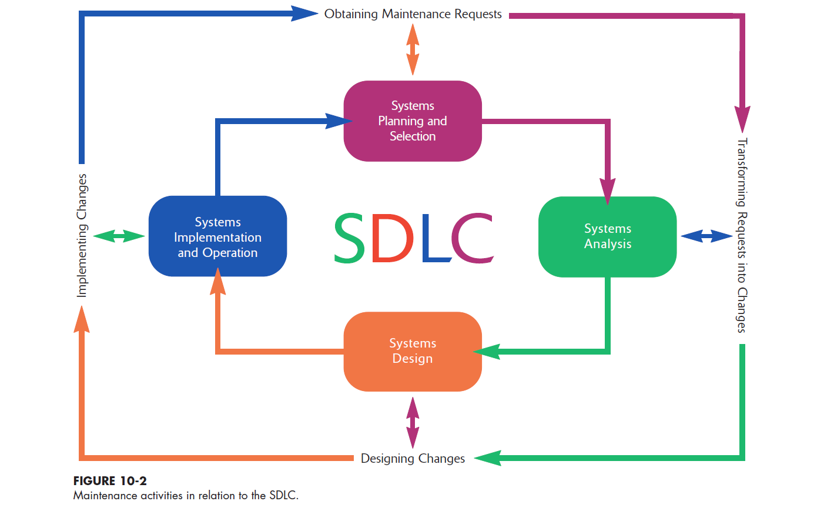
10.9

Slide 10
The Process of Maintaining Information Systems (continued)
Deliverables and Outcomes
  Development of a new version of the software, new versions of all design documents, and training materials created or modified during the maintenance effort
10.10

Slide 11
Software Application Testing
A test plan is developed during the analysis phase
During the design phase, a unit test plan and a system test plan are developed
The actual testing is done during implementation
Test plans provide improved communication among all parties involved in testing
  Serve as checklists
10.11

Slide 12
Software Application Testing
Types of Testing
Inspection
  A testing technique in which participants examine program code for predictable language-specific errors
Walkthrough
  A peer group review of any product created during the systems development process; also called a structured walkthrough
Desk Checking
  A testing technique in which the program code is sequentially executed manually by the reviewer
10.12

Slide 13
Software Application Testing
Types of Testing (continued)
Unit Testing
  Each module is tested alone in an attempt to discover any errors in its code, also called module testing
Integration Testing
  The process of bringing together all of the modules that a program comprises for testing purposes; modules are typically integrated in a top-down, incremental fashion
10.13

Slide 14
Software Application Testing
Types of Testing (continued)
System Testing
  The bringing together of all the programs that a system comprises for testing purposes; programs are typically integrated in a top-down, incremental fashion
Stub Testing
  A technique used in testing, especially where modules are written and tested in a top-down fashion, where a few lines of code are used to substitute for subordinate modules
10.14

Slide 15
Software Application Testing
The Testing Process
The purpose of the testing is to confirm that the system satisfies requirements
Testing must be planned
Test Case
  A specific scenario of transactions, queries, or navigation paths that represent a typical, critical, or abnormal use of the system
  Test cases and results should be thoroughly documented so they can be repeated for each revision of an application
10.15

Slide 16
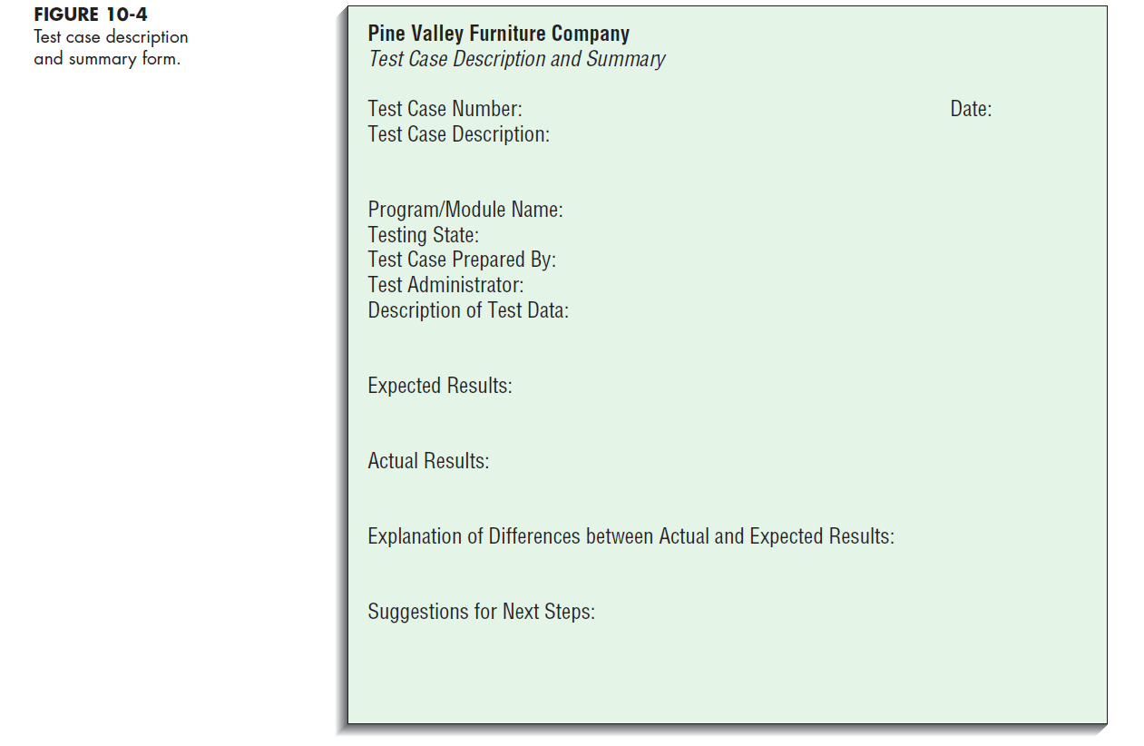
10.16

Slide 17
Software Application Testing:
Acceptance Testing by Users
The process whereby actual users test a completed information system, the end result of which is the users’ acceptance of it
Alpha Testing
  User testing of a completed information system using simulated data
  Recovery testing
    Forces the software (or environment) to fail in order to verify that recovery is properly performed
  Security testing
    Verifies that protection mechanisms built into the system will protect it from improper penetration
  Stress testing
    Tries to break the system
10.17

Slide 18
Software Application Testing:
Acceptance Testing by Users (continued)
Alpha Testing (continued)
  Performance testing
    Determines how the system performs on the range of possible environments in which it may be used
Beta Testing
  User testing of a completed information system using real data in the real user environment
10.18

Slide 19
Installation
The organizational process of changing over from the current information system to a new one
Four approaches
  Direct Installation
    Changing over from the old information system to a new one by turning off the old system when the new one is turned on
  Parallel Installation
    Running the old information system and the new one at the same time until management decides the old system can be turned off
10.19

Slide 20
Installation (continued)
  Single location installation
    Trying out an information system at one site and using the experience to decide if and how the new system should be deployed throughout the organization
  Phased Installation
    Changing from the old information system to the new one incrementally, starting with one or a few functional components and then gradually extending the installation to cover the whole new system
10.20

Slide 21
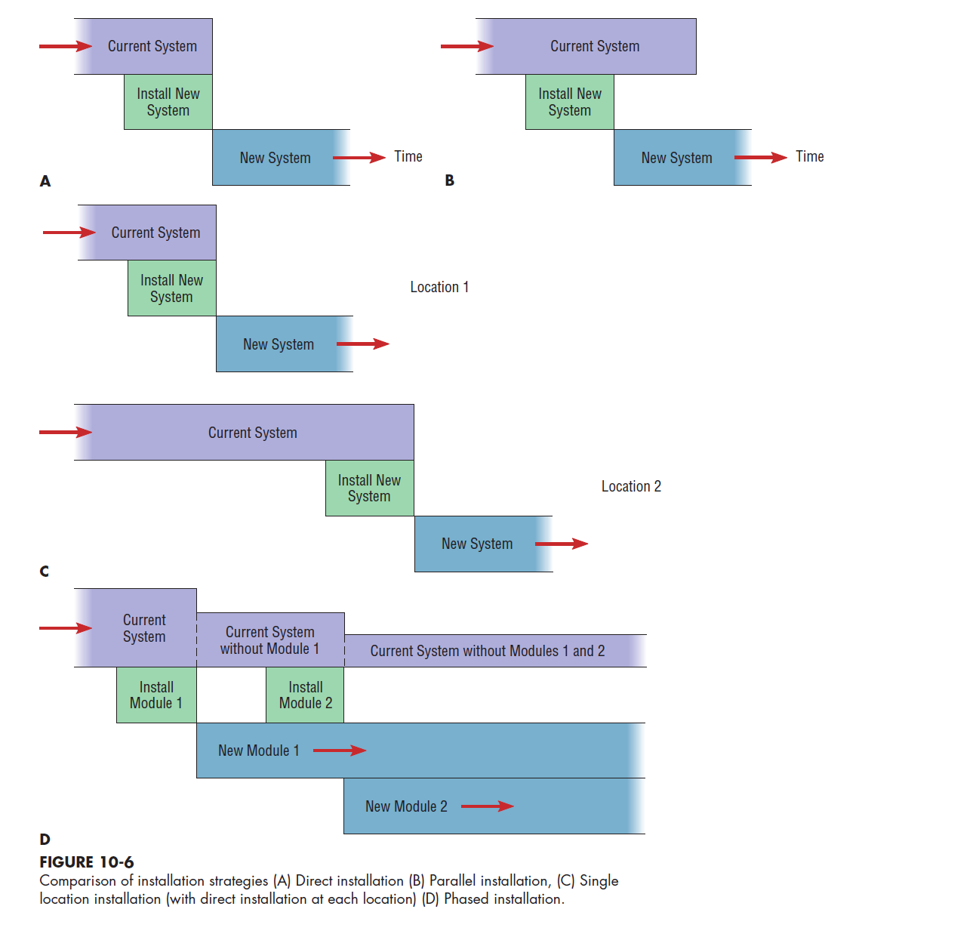
10.21

Slide 22
Planning Installation
Considerations
  Data conversion
    Error correction
    Loading from current system
  Planned system shutdown
  Business cycle of organization
10.22

Slide 23
Documenting the System
System Documentation
  Detailed information about a system’s design specifications, its internal workings, and its functionality
  Internal documentation
    System documentation that is part of the program source code or is generated at compile time
  External documentation
    System documentation that includes the outcome of structured diagramming techniques such as data-flow and entity-relationship diagrams
10.23

Slide 24
Documenting the System (continued)
User Documentation
  Written, or other visual information, about an application system, how it works, and how to use it
Preparing User Documentation
  Traditional source has been information systems department
  Application-oriented documentation is now often supplied by vendors and users themselves
10.24

Slide 25
Training Information System Users
Potential Training Topics
  Use of the system
  General computer concepts
  Information system concepts
  Organizational concepts
  System management
  System installation
10.25

Slide 26
Training Information System Users (continued)
Training Methods
  Resident expert
  Computer-aided instruction
  Formal courses
  Software help components
  Tutorials
  Interactive training manuals
  External sources, such as vendors
10.26

Slide 27
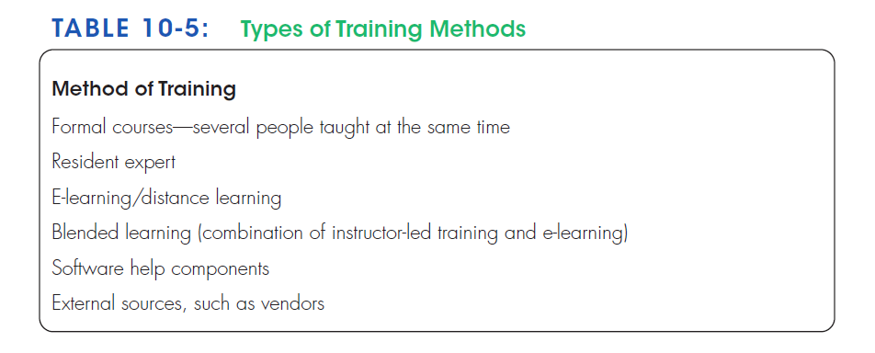
10.27

Slide 28
Training Information System Users (continued)
Electronic performance support system (EPSS)
  Component of a software package or application in which training and educational information is embedded
10.28

Slide 29
Supporting Information System Users
Support is extremely important to users
  Need for support driven by
    Lack of standards
    Need to make equipment and software from different vendors compatible
Most organizations provide support by several means:
  Automated issue tracker
  Automated support
  Help desk
10.29

Slide 30
Supporting Information System Users Help Desk
A single point of contact for all user inquiries and problems about a particular information system or for all users in a particular department
10.30

Slide 31
Why Implementation Sometimes Fails
Two conditions necessary for a successful implementation:
  Management support of the system under development
  Involvement of users in the development process
10.31

Slide 32
Why Implementation Sometimes Fails (continued)
Insights about implementation process
  Risk
  Commitment to the project
  Commitment to change
  Extent of project definition and planning
  Realistic user expectations
10.32

Slide 33
Why Implementation Sometimes Fails (continued)
Implementation success factors
  Extent to which system is used
  System ease of use and reliability
  Users’ satisfaction with system
  User demographics, such as age and degree of computer experience
10.33

Slide 34
Project Closedown
Evaluate team
  Reassign members to other projects
Notify all affected parties that the development project is ending and that you are switching to operation and maintenance mode
Conduct post project reviews
Close out customer contract
  Formal signoff
10.34

Slide 35
Conducting System Maintenance:
Types of Maintenance
Corrective maintenance
  Changes made to a system to repair flaws in its design, coding, or implementation
Adaptive maintenance
  Changes made to a system to evolve its functionality to changing business needs or technologies
Perfective maintenance
  Changes made to a system to add new features or to improve performance
Preventive maintenance
  Changes made to a system to avoid possible future problems
10.35

Slide 36
Conducting System Maintenance:
The Cost of Maintenance
Many organizations allocate as much as 60 to 80 percent of information systems budget to maintenance
Factors that influence system maintainability:
  Latent defects
  Number of customers for a given system
  Quality of system documentation
  Maintenance personnel
  Tools
  Well-structured programs
10.36

Slide 37
Conducting System Maintenance
Measures of Effectiveness
Number of Failures
Time between Each Failure
Type of Failure
Mean Time between Failures (MTBF)
  A measurement of error occurrences that can be tracked over time to indicate the quality of a system
10.37

Slide 38
Controlling Maintenance Requests
Determine type of request
  Error
  Adaptation
  Enhancement
Figure 10-10 shows a flowchart for a request procedure
10.38

Slide 39
10.39

Slide 40
Configuration Management
The process of assuring that only authorized changes are made to the system
Baseline Modules
  Software modules that have been tested, documented, and approved to be included in the most recently created version of a system
System Librarian
  A person responsible for controlling the checking out and checking in of baseline modules when a system is being developed or maintained
Build Routines
  Guidelines that list the instructions to construct an executable system from the baseline source code
10.40

Slide 41
Role of Automated Development Tools in Maintenance
Design Documents are maintained instead of source code
Code is generated from design documents
Documentation changes are made during maintenance phase
Design recovery tools for older systems
  Reverse engineering
  Re-engineering
10.41

Slide 42
Web Site Maintenance
Special procedures needed due to nature and operational status
24 x 7 x 365, continuous operation
Broken link checks
Re-registration
Future Editions
10.42

Slide 43
PVF WebStore: Systems Implementation and Operation
System implementation and operation of an Internet-based electronic commerce project is no different than other projects
Develop Test Cases
  Simple functionality
  Multiple functionality
  Function chains
  Elective functions
  Emergency/crisis
Bug Tracking and System Evolution
Alpha and Beta Testing the WebStore
WebStore Installation
10.43

Slide 44
Summary
Process of coding, testing, and converting an organizational information system
Four installation strategies:
  Direct
  Parallel
  Single location
  Phased installation
10.44

Slide 45
Summary (continued)
Documentation
  System
  User
User Training
Providing Support for End Users
Systems Implementation Failures
10.45

Slide 46
Summary (continued)
Maintenance
  Corrective
  Adaptive
  Perfective
  Preventive
Cost of Maintenance
Measuring Effectiveness of Maintenance
10.46

Slide 47
Summary (continued)
Controlling Maintenance Requests
Configuration Management
Roles of Automated Tools
Web Site Maintenance
Internet Development
10.47

Slide 48

All rights reserved. No part of this publication may be reproduced, stored in a retrieval system, or transmitted, in any form or by any means, electronic, mechanical, photocopying, recording, or otherwise, without the prior written permission of the publisher. Printed in the United States of America.
Copyright © 2015 Pearson Education, Inc.
Publishing as Prentice Hall

